Slide 1
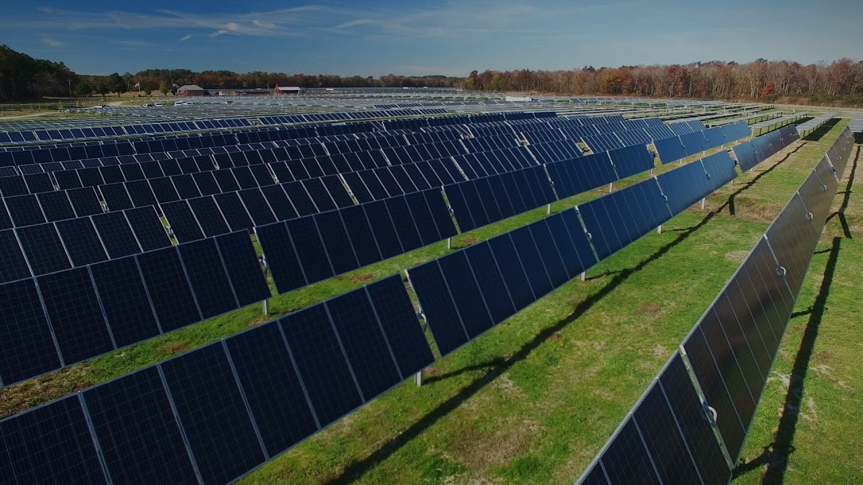

AMAZON 150 MW Utility – Scale Solar Farm
Project Manager: Daniela Gutierrez, Thanh Tung Le, Worrel Lee, Namira Rupani
Project Sponsor: Amazon Web Services (AWS)
Date: November 02, 2026
Location: Northern Virginia
Notes:
Find a better name for the project or a cool name

Slide 2
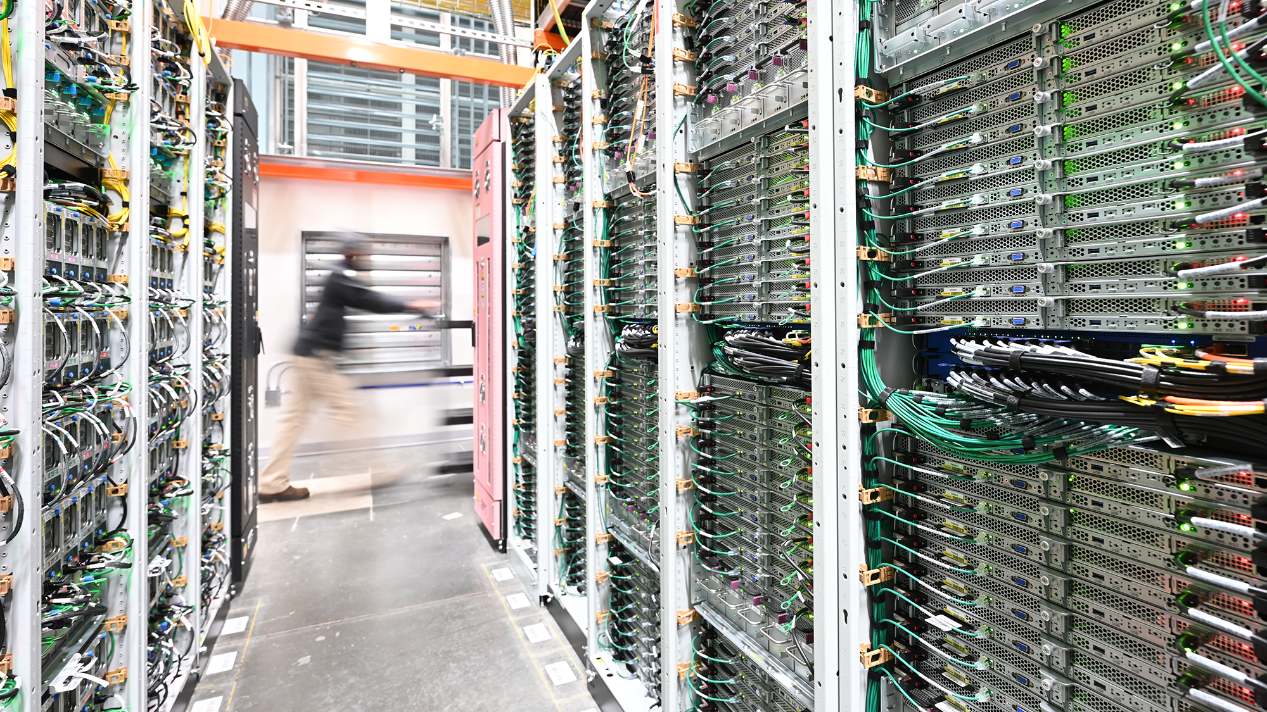


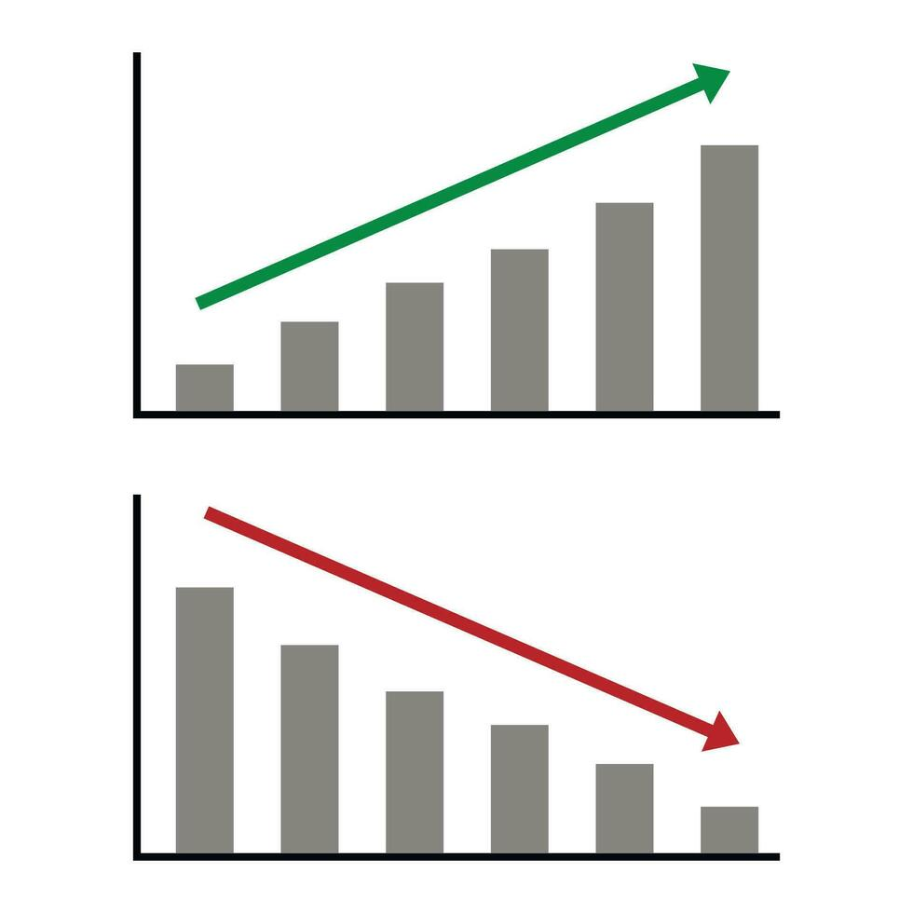
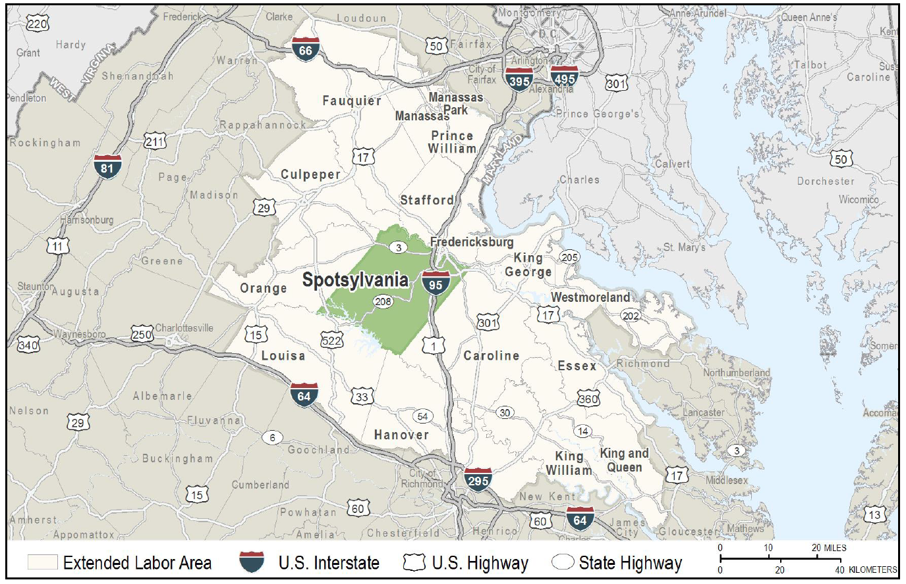
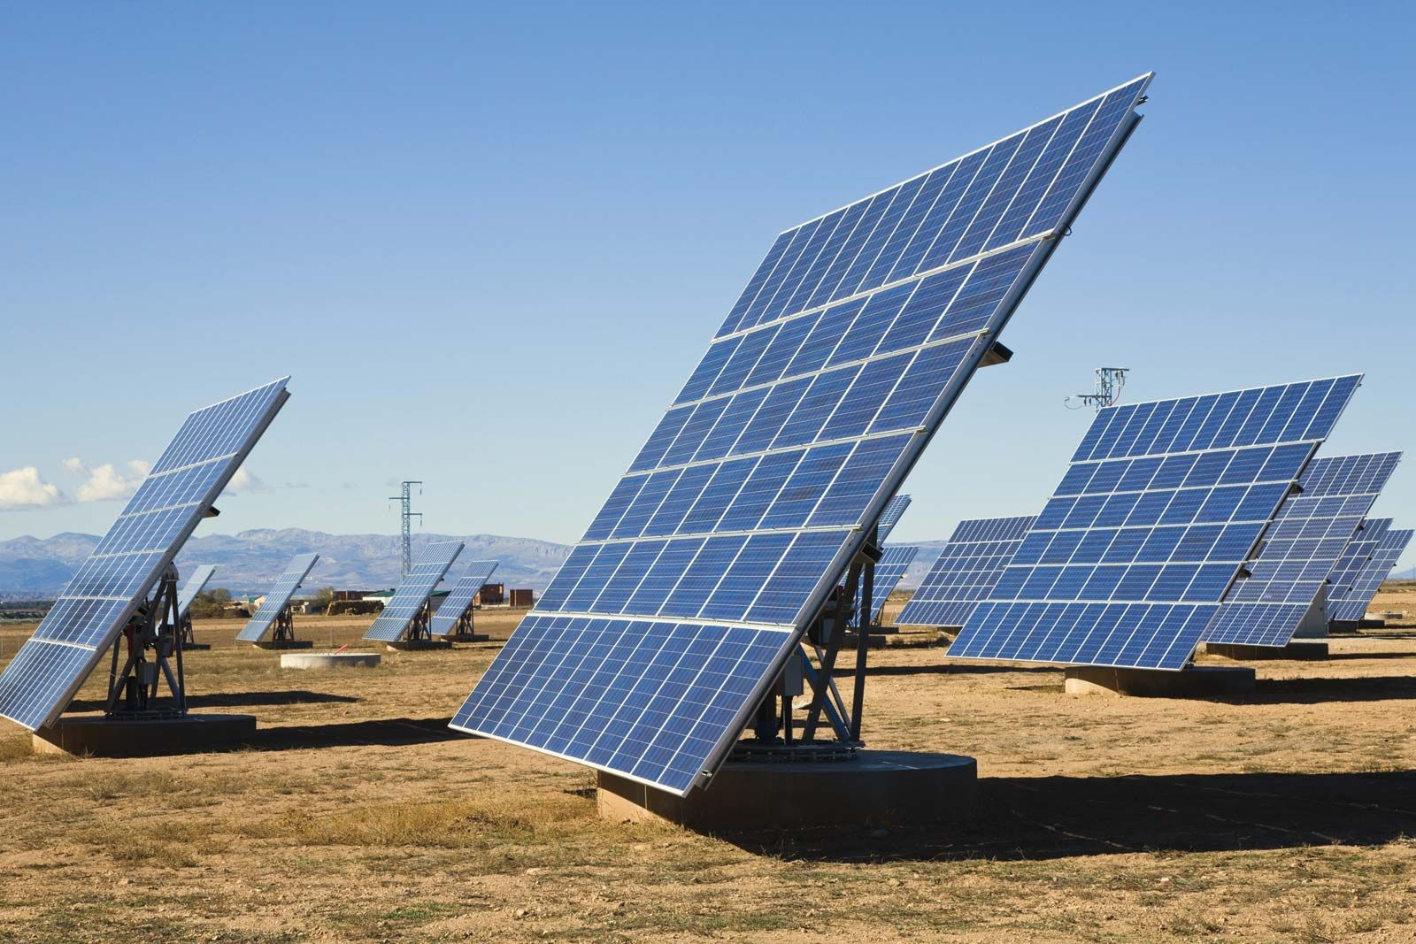
AMAZON 150 MW Utility – Scale Solar Farm ​
Design and construct a 150 MW utility-scale solar farm with battery storage and grid interconnection to support Amazon’s renewable energy needs.
Targets net-zero carbon emissions by 2040
AWS operates one of the world’s largest data center networks,
Continuous, reliable power to support global cloud services
The 150 MW solar farm helps close the renewable energy gap for AWS operations
Spotsylvania County offers strong solar resources, low environmental risk, and supportive policies
Rapid data center growth has outpaced renewable energy capacity
Notes:
Add the value proposition and the numerical value
Why is Amazon doing this
What is going to be the return for them ($)

Slide 3





Schedule & Milestone
Milestone | Target Date (from Project Start ) | Acceptance Criteria
Project Initiation & Site Selection | Month 6 | Site acquired; preliminary feasibility study approved
Permitting & Interconnection Approval | Month 12 | All regulatory approvals secured; utility interconnection agreement signed
Detailed Design Complete | Month 18 | Engineering drawings finalized and approved; equipment specifications locked
Procurement | Month 21 | Solar panels, batteries, and major equipment ordered and on schedule; mobilization plan approved
Construction Complete | Month 36 | Solar panels, battery energy storage system, and grid physically installed
Commissioning & Testing | Month 39 | Acceptance tests passed; on-site performance verified; grid synchronization successful
Commercial Operation | Month 42 | First energy delivered
Notes:
Add to the milestone when we are done
meaning when do we know that the project is done

Slide 4


Risk, Assumptions & Constraints
Risks:
Permitting delays, supply chain disruptions, cost escalation, weather, tax incentive changes
Permitting & interconnection approval delays
Supply chain disruptions (panels, batteries, equipment)
Construction cost escalation
Severe weather during construction
Community opposition to project
Changes to federal tax incentives

Slide 5
Risk, Assumptions & Constraints
Assumptions:
High solar resource with consistent sunshine
Federal ITC remains at 30% through completion
Stable regulatory environment
Predictable equipment lead times (panels & batteries)
Grid can accommodate 150 MW without major upgrades
Project Constraints:
Budget: Capital cost approx. $210M
Schedule: Commercial operation by Month 42
Technical: Interconnection to 230 kV lines within 2 miles
Environmental: No impact to protected areas; 100-ft buffer
Regulatory: Compliance with state and local requirements

Slide 6
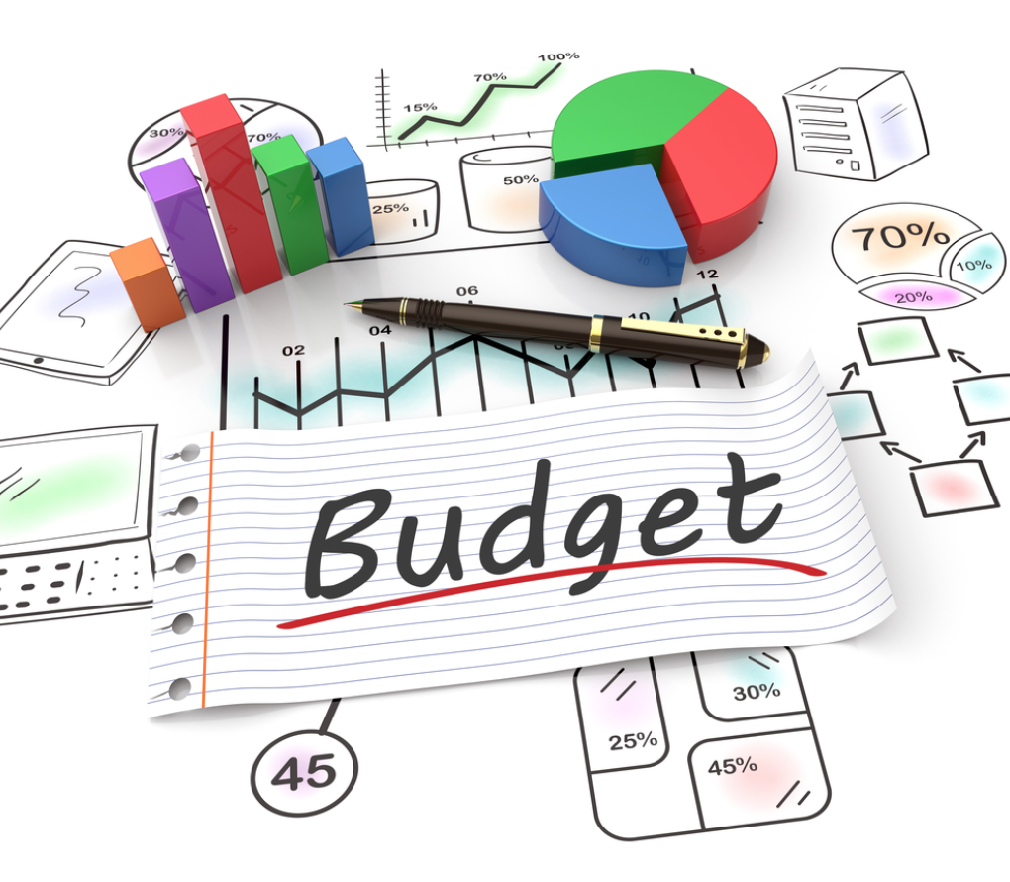
Budgeting & Resources
WBS L1 | Category | Category Total | % of Total
1 | Project Management & Governance | $77,222,200 | 14.12%
2 | Site Control, Environmental & Permitting | $5,900,000 | 1.08%
3 | Engineering & Design | $5,500,000 | 1.01%
4 | Financing, PPA & Tax Equity Structure | $3,150,000 | 0.58%
5 | Procurement & Contracting | $5,400,000 | 0.99%
6 | Civil & Structural Works | $62,350,000 | 11.40%
7 | Electrical Systems & BESS | $346,698,000 | 63.40%
8 | SCADA, Communications & Controls | $11,500,000 | 2.10%
9 | Testing, Commissioning & Interconnection | $20,500,000 | 3.75%
10 | Handover, Documentation & Closeout | $5,900,000 | 1.08%
INC | Incidentals | $2,750,000 | 0.50%
Total Project Cost: $546,870,200
Notes:
Look for the budget

Slide 7

Stakeholders & Governance
Stakeholders
Stakeholder | Priority | Interest in Project
Amazon Leadership | Key | Achieving project goals – Impact & Interest
AWS Data Center Operations | Key | Reliable power supply, 24/7 dispatchability – Impact & Interest
Contractors | Key | Scope delivery, construction quality and safety Impact and Interest
Utility/Grid Operator | Key | Grid interconnection success, regulatory compliance – Impact and Interest
Local Government/ Regulators | Key | Tax revenue generation, legal and environmental compliance )Impact and Interest
Local Community/ Landowners | Other | Economic benefits, minimal disruption Impact and Interest
Labor Unions/Trades | Other | Hiring opportunities, safe working conditions, fair wages Impact and Interest
Environmental NGOs | Other | Biodiversity protection, habitat preservation
Governance
Executive Sponsor
Quarterly reviews
Steering Committee
Monthly
Core Working Team
Project Management Office
Subject Matter Expert
Weekly
Daily
Ad-hoc when needed
Notes:
Impact and Interest
Diagram y and x axis or pain scale

Slide 8

Lesson Learned
Site selection is critical: Repurpose contaminated sites accelerates permitting, saves costs and promotes positive PR
Parallel permitting saves time: Run environmental, zoning, and interconnection studies simultaneously
Community benefits upfront: Projects with proactive local hiring and community contributions achieved faster permit approval and avoid backlash
Dual land use: A North Carolina solar farm that incorporated sheep grazing beneath the panels increased local support and generated an additional revenue stream.

Slide 9


Signatures
……………………………, Sponsor _______________________________________________
Signature Date
……………………………, Project Manager ______________________________________________
Signature Date
……………………………, Functional Manager ______________________________________________
Signature Date
……………………………, Team Member ______________________________________________
Signature Date
Commitment:
We understand and accept the responsibilities and conditions described in this document and jointly agree to abide by all applicable policies and requirements.

Slide 10

Project organization structures: Matrix
Team members split time between project and functional roles
Dedicated full-time Project Manager with significant authority
Resources borrowed from Engineering, Finance, Legal, Environmental departments
Why Matrix? Balances project focus with functional expertise
PM controls day-to-day decisions
After project completion, team returns to functional departments in AWS
Notes:
Project Charter and Stakeholder Map
For Stakeholder Map use Diagram – Interest & Impact Example

Slide 11
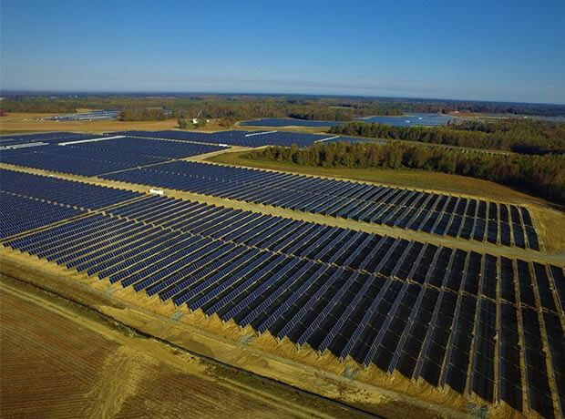
Project Name: Project Helios
Objective: Amazon's 150 MW Utility Scale Solar Farm
Place: Virginia, Spotsylvania County
Start Date: November 2026
Budget: $500 Millions
NPV: $174 Million Revised
Sponsor: Amazon Web Services (AWS)
Value Proposition: We generate 150 megawatts of clean power for AWS data centers. We lock in fixed-cost energy for 20 years. We fulfill Amazon's Climate Pledge commitment with a measurable, permanent physical asset. And we create a structural competitive moat in Virginia's energy market that no competitor can replicate.
Project Helios
Scope: Design and construct a 150 MW utility-scale solar farm with battery storage and grid interconnection to support Amazon’s renewable energy needs.
Milestones: Month 8: Site acquisition and feasibility study complete, Month 12: All permits and interconnection approvals secured, Month 18: Engineering design finalized, Month 34: Equipment procurement complete, Month 45: Construction complete, Month 48: Testing and commissioning successful, Month 50: Commercial operation begins - (4 Years 2 months)
Project Sponsor:
__________________________________
Director of Energy & Infrastructure, AWS
Date: ____________
Project Manager:
__________________________________
Daniela Gutierrez, Thanh Tung Le, Lee Worrel, Namira Rupani
Date: ____________
Steering Committee:
__________________________________
AWS VP of Infrastructure
Date: ____________
Steering Committee:
_______________
Amazon Director of Sustainability
Date: ____________
Notes:
Important Links:
https://www.aboutamazon.com/news/sustainability/amazon-renewable-energy-portfolio-january-2024-update\
ULTIMATE VALUE PROPOSITION (Use This as Your North Star):
"WHY THIS PROJECT MATTERS"
Project Sunshine is more than a solar farm—it's a strategic investment!
Secures Amazon's energy future with 20 years of stable, predictable renewable power
Delivers measurable financial returns ($42M NPV, $2M annual savings, $63M tax credit) - Review and do this before with 310M USD
Advances corporate sustainability leadership toward Climate Pledge commitments
Ensures operational excellence with 24/7 dispatchable power and zero downtime risk
Creates community value through jobs, tax revenue, and agricultural preservation
Generates environmental impact equivalent to removing 30,000 cars from roads annually
Provides a replicable model that Amazon can scale across dozens of data center locations
In short: Project Sunstone proves that sustainability and profitability aren't competing priorities—they're complementary strategies that create long-term value for all stakeholders.

Slide 12
Stakeholder Map
Amazon Worldwide Communications | 😑
Insurance Providers | 😊
Competitors | 🙁
AWS (Infra / DC Ops) | 😊
Amazon Energy & Sustainability | 😊
Amazon Supporting Departments | 😑
EPC Contractor (Engineering, Procurement, and Construction) -Review | 😊
Vendors or Suppliers | 😊
Tax Equity Investors (Bank) | 😊
Local Landowners/Lessees | 😊
Labor Unions | 😊
High Interest
Environmental/Conservation Groups | 🙁
Local Community Organizations | 😑
Amazon Shareholders | 😑
Federal Energy Regulatory Commission | 😑
State Energy Commission | 😑
Regional transmission organization - PJM | 😑
Utility/Grid Operator | 😑
Local/County Zoning Board | 😑
Environmental Protection Agency | 😑
Low Interest
Low Impact
High Impact
Notes:
MOVE TO HIGH IMPACT / HIGH INTEREST:
1. Federal Energy Regulatory Commission
Why: They MUST approve interstate electricity transmission. No approval = project can't operate legally.
2. State Energy Commission
Why: They approve all utility-scale power projects in Virginia. They can deny the entire project.
3. Environmental Protection Agency
Why: They enforce environmental laws. EPA violations can shut down construction immediately.
4. Vendors/Suppliers (Solar panels, batteries)
Why: If panels don't arrive, construction stops. 8-month delay costs $3M+ and risks missing tax credit deadline.
5. Local Landowners
Why: No land = no project. If they refuse to sell the 550 acres, you have nowhere to build.
MOVE TO HIGH IMPACT / LOW INTEREST:
6. Amazon Shareholders
Why: They vote on major capital allocations. If unhappy, they can pressure executives to cancel the $300M investment. (High power, but don't care about daily details)
MOVE TO MEDIUM IMPACT / HIGH INTEREST:
7. Environmental/Conservation Groups
Why: They can't stop the project alone, BUT they can organize opposition that delays permits by 6-12 months. Medium blocking power, very high interest.
8. Local Community Organizations
Why: They influence the County Zoning Board. If community opposes loudly at public hearings, zoning board may deny permits. Medium influence, high interest.

Slide 13
Stakeholder List
Amazon Worldwide Communications | 😑
Insurance Providers | 😊
Competitors | 🙁
Environmental/Conservation Groups | 🙁
Local Community Organizations | 😑
Amazon Shareholders | 😑
AWS (Infra / DC Ops) | 😊
Amazon Energy & Sustainability | 😊
Amazon Finance | 😑
Amazon General Counsel & Secrectary | 😑
EPC Contractor (Engineering, Procurement, and Construction) | 😊
Battery Storage Vendor (BESS supplier) | 😊
Solar Panel/Module Suppliers | 😊
Inverter/Power Electronics Vendors | 😊
Tax Equity Investors | 😊
Local Landowners/Lessees | 😊
Labor Unions | 😊
Utility/Grid Operator | 😑
Regional transmission organization - PJM | 😑
State Energy Commission | 😑
Environmental Protection Agency | 😑
Local/County Zoning Board | 😑
Federal Energy Regulatory Commission | 😑
Notes:
HIGH IMPACT / HIGH INTEREST (Must Actively Manage)
✅ AWS (Infra / DC Ops)
✅ Amazon Energy & Sustainability
✅ Amazon Executive Leadership ← ADD
✅ Amazon Finance/CFO ← ADD
✅ EPC Contractor
✅ Vendors/Suppliers ← MOVE HERE
✅ Tax Equity Investors
✅ Local Landowners ← MOVE HERE
✅ PJM (Regional Transmission Org)
✅ Utility/Grid Operator
✅ Local/County Zoning Board
✅ Federal Energy Regulatory Commission ← MOVE HERE
✅ State Energy Commission ← MOVE HERE
✅ Environmental Protection Agency ← MOVE HERE
✅ Owner's Engineer ← ADD
✅ Financial Advisors ← ADD
HIGH IMPACT / LOW INTEREST (Keep Satisfied)
✅ Amazon Shareholders ← MOVE HERE
✅ IRS ← ADD
✅ Amazon Legal ← ADD
✅ Credit Rating Agencies ← ADD
LOW IMPACT / HIGH INTEREST (Keep Informed)
✅ Labor Unions
✅ Environmental/Conservation Groups ← MOVE HERE (or Medium Impact)
✅ Local Community Organizations ← MOVE HERE (or Medium Impact)
✅ Environmental Consultants ← ADD
LOW IMPACT / LOW INTEREST (Monitor)
✅ Amazon Worldwide Communications
✅ Insurance Providers
✅ Competitors

Slide 14
Key Venture Milestone
Site Control & Permitting
WBS 2.1 Site Feasibility Complete – Dec 26,2026
Confirms the site is technically and commercially viable before the project commits major resources. Validates solar resource, grid proximity, land availability, and environmental constraints
WBS 2.2 Site Control Secured – June 11,2027
All land agreements, easements, and title recordings are executed. The project has legal control of the site — the physical and legal foundation that everything else is built upon.
WBS 2.4 Local Permitting Secured – October 29,2027
All zoning approvals, building permits, and AHJ sign-offs are obtained. This is the regulatory green light that allows physical construction to legally begin on site.
Engineering & Design
WBS 3.1 Conceptual Design Complete -
Confirms the site is technically and commercially viable before the project commits major resources. Validates solar resource, grid proximity, land availability, and environmental constraints
WBS 2.2 Site Control Secured – June 11,2027
All land agreements, easements, and title recordings are executed. The project has legal control of the site — the physical and legal foundation that everything else is built upon.
WBS 2.4 Local Permitting Secured – October 29,2027
All zoning approvals, building permits, and AHJ sign-offs are obtained. This is the regulatory green light that allows physical construction to legally begin on site.
Notes:
Project Charter and Stakeholder Map
For Stakeholder Map use Diagram – Interest & Impact Example

Slide 15
Contractor Legend
Turner & Townsend
Terracon
Sargent & Lundy
Project Managemnet -Working with Helios
FEED & Permitting
Detailed Design
Amazon
JPMorgan Chase
MasTec Renewables
Procurement & PPA
Financing
Civil & Structural
Primoris Services
Intertek
Black & Veatch
Electrical & BESS
Commissioning
O&M & Closeout

Slide 16
CONTRACTOR QUILT
Project Phase
Turner & Townsend
Terracon
Sargent & Lundy
Amazon
JPMorgan Chase
MasTec Renewables
Primoris Services
Intertek
Black & Veatch
WBS 1 — PM & Governance
●
●
●
●
●
●
●
●
●
WBS 2 — Site & Permitting
●
●
●
●
●
WBS 3 — Engineering & Design
●
●
●
●
●
●
●
●
WBS 4 — Financing & PPA
●
●
●
WBS 5 — Procurement
●
●
●
●
●
●
WBS 6 — Civil Works
●
●
●
●
●
●
WBS 7 — Electrical & BESS
●
●
●
●
●
●
WBS 8–9 — Commissioning
●
●
●
●
●
●
●
WBS 10 — Closeout
●
●
●
●
●
●
●
●

